Slide 1

DSAI PROJECT:
AVIATION
Group T08:
Mark Tan
Shauna Tan
Jia Wen
Swee Sing

Slide 2
01
PROBLEM STATEMENT
02
CLEANING THE DATA
TABLE OF CONTENTS
03
DATA ANALYSIS
04
NAIVE BAYES
05
CONCLUSION

Slide 3


PROBLEM
STATEMENT
01

Slide 4


WHAT IS THE PROBLEM?
Dataset used is the NTSB Aviation Accident Dataset
Problem: Classification
Objective: To identify significant variables that can accurately predict the Injury Severity of accidents, i.e. whether the accident is fatal or non-fatal

Slide 5

CLEANING THE DATA
02

Slide 6
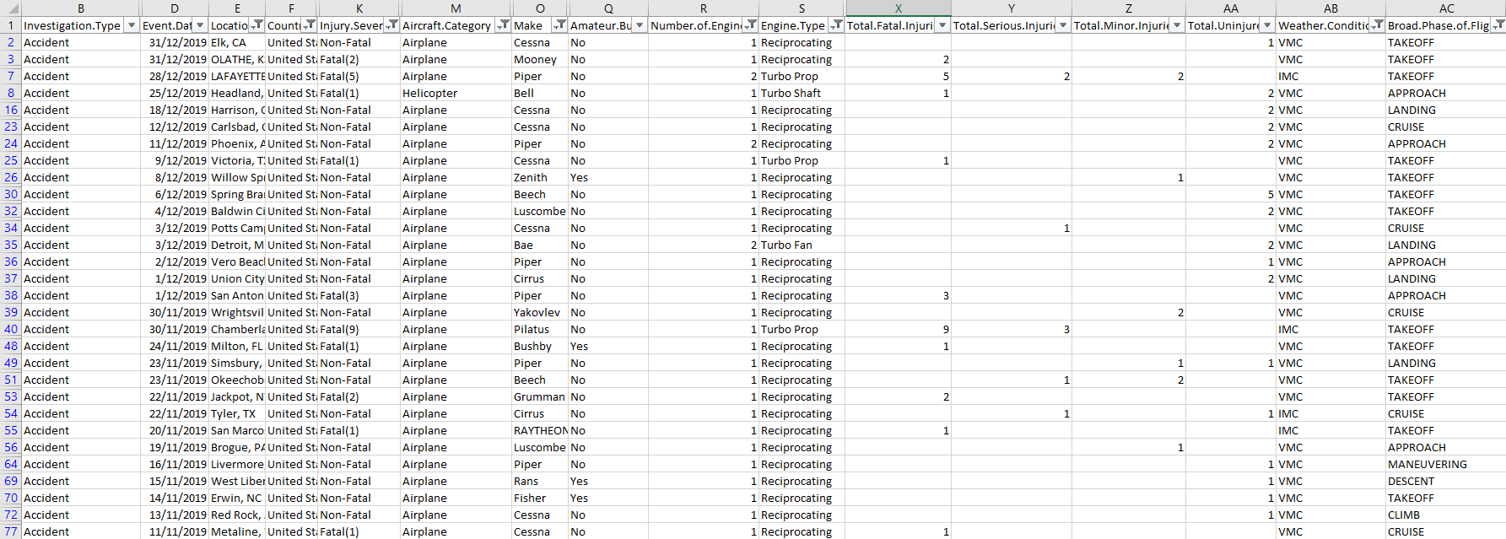
DROP COLUMNS
REMOVE ROWS WITH BLANKS/UNKNOWNS
CLEANING THE DATA
OTHER SPECIFIC CLEANING
OTHER SPECIFIC CLEANING
Drop the columns unrelated to accidents or those which contain data we do not need, for example:
Event ID
Registration Number
Publication Data
Blanks or unknown data do not provide us with any significant information
For Injury Severity:
Change Fatal(n), where n is the number of fatalities, to just Fatal
For Make:
Standardised casing (1st letter uppercase, followed by lowercase for the rest of the letters
Filter the data to include only Accidents (under Investigation Type) and those in USA (under Country)
Notes:
- Mention that we didn’t clean the data for aircat here, bc if we do then we’ll lose a lot of data from the start, so we clean separately later when we analyse aircat
- Can say our data roughly looks like the screen shot

Slide 7


DATA
ANALYSIS
03
03

Slide 8
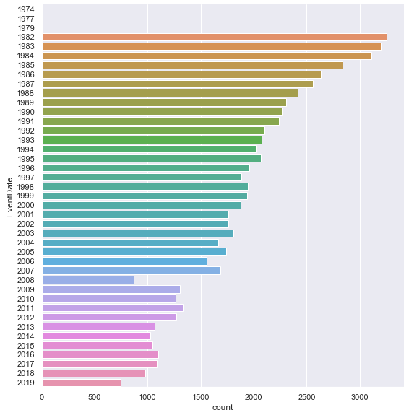
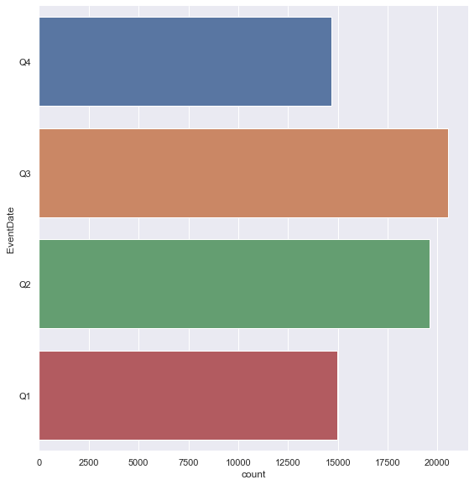
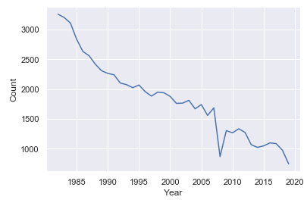

EVENT DATE
Bar Plot of Number of Accidents per Quarter
Line Plot of Number of Accidents per Year
Bar Plot of Number of Accidents Per Year

Slide 9
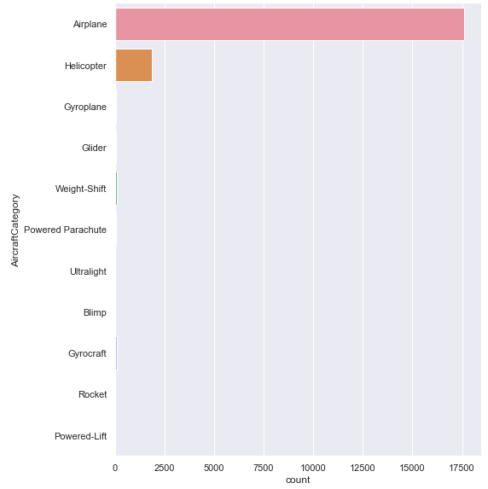

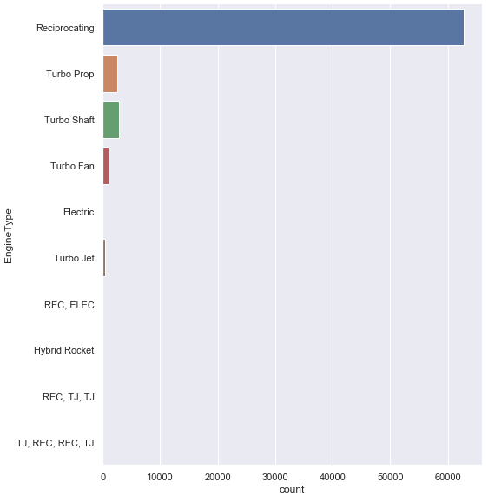

ENGINE TYPE
AIRCRAFT CATEGORY

Slide 10


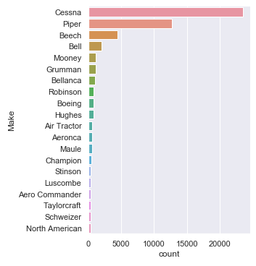
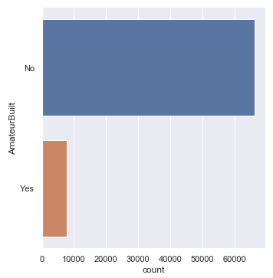
AIRCRAFT MAKE
AMATEUR BUILT

Slide 11


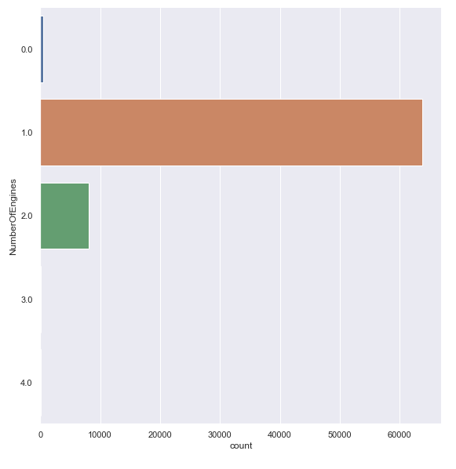
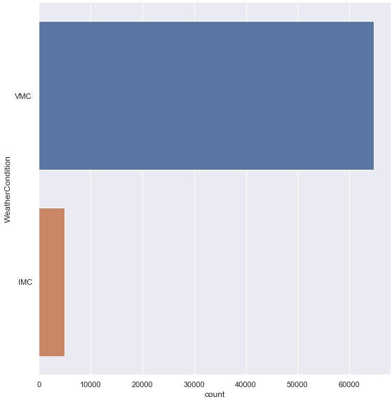
NUMBER OF ENGINES
WEATHER CONDITION

Slide 12
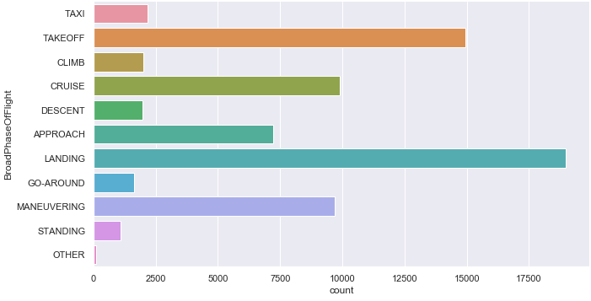
BROAD PHASE OF FLIGHT

Slide 13
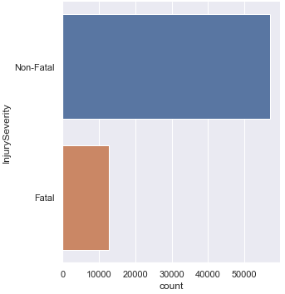
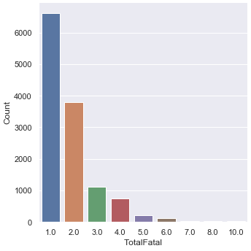
TOTAL FATAL INJURIES
INJURY SEVERITY
INJURY BREAKDOWN

Slide 14
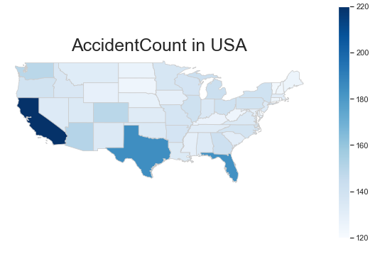
DISTRIBUTION
Mercury is the closest planet to the Sun and the smallest one in our Solar System—it’s only a bit larger than our Moon. The planet’s name has nothing to do with the liquid metal, since it was named after the Roman messenger god

Slide 15

NAÏVE BAYES
04
Notes:
Explain Naïve Bayes Algorithm
Naïve Bayes calculates probability of target variable based off other key variables
Problem statement is classification, fits Naïve Bayes as it is a classification algorithm
Variables used in dataset for predicting mainly categorical, Naïve bayes perfect as it predicts probability with classes, while other classification algorithms cant use categorical datatypes

Slide 16
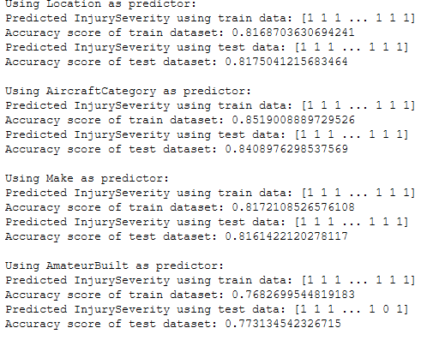
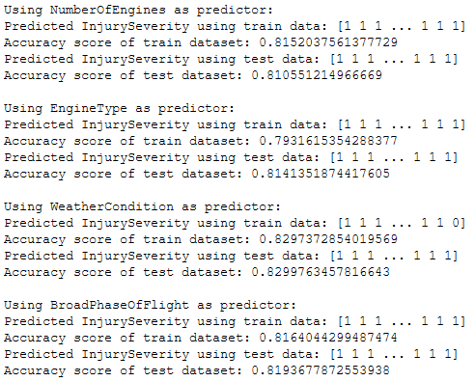
SINGLE VARIABLE PREDICTION

Slide 17
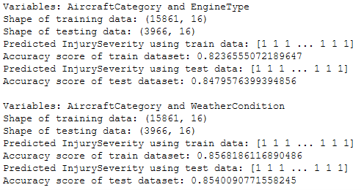
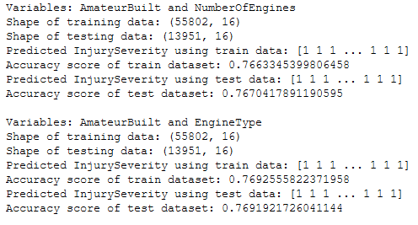
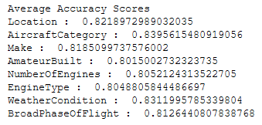
Aircraft Category Pairs
TWO VARIABLE PREDICTION
Average Accuracy Scores
Amateur Built Pairs

Slide 18
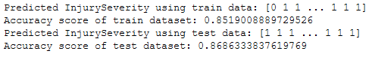
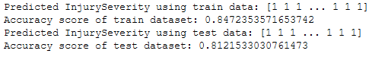
MULTI VARIABLE PREDICTION
6-Variables
8-Variables

Slide 19
CONCLUSION
03
05

Slide 20
INTERESTING FINDINGS
Data heavily skewed
Visible differences in accuracy scores of variables

Slide 21
WORK DISTRIBUTION
Data Cleaning – Shauna & Mark
Data Analysis – Shauna & Mark
Naïve Bayes Research & Implementation – Jia Wen
Naive Bayes (Additional) – Jia Wen, Shauna, Mark
Slides – Shauna, Mark

Slide 22
Q & A

